Slide 1
CSI5311 Distributed Databases and Transaction Processing
Iluju Kiringa
Text book: T. Ozsu and P. Valduriez, Principles of Distributed Database Systems, 3rd edition, Springer 2011
Notes based on those by TO and PV

Slide 2
File Systems
program 1
File 1
data description 1
program 2
data description 2
File 2
program 3
data description 3
File 3

Slide 3
Database Management
Application
program 1
(with data
semantics)
DBMS
description
Application
program 2
(with data
semantics)
manipulation
database
control
Application
program 3
(with data
semantics)

Slide 4
Motivation
Database
Technology
Computer
Networks
integration
distribution
Distributed
Database
Systems
integration
integration ≠ centralization

Slide 5
Distributed Computing
A number of autonomous processing elements (not necessarily homogeneous) that are interconnected by a computer network and that cooperate in performing their assigned tasks.
What is being distributed?
Processing logic
Function
Data
Control

Slide 6
What is a Distributed Database System?
A distributed database (DDB) is a collection of multiple, logically interrelated databases distributed over a computer network.
A distributed database management system (D–DBMS) is the software that manages the DDB and provides an access mechanism that makes this distribution transparent to the users.
Distributed database system (DDBS) = DDB + D–DBMS

Slide 7
What is not a DDBS?
A timesharing computer system
A loosely or tightly coupled multiprocessor system
A database system which resides at one of the nodes of a network of computers - this is a centralized database on a network node

Slide 8
Centralized DBMS on a Network
Site 1
Site 2
Site 5
Communication
Network
Site 4
Site 3

Slide 9
Distributed DBMS Environment
Site 1
Site 2
Site 5
Communication
Network
Site 4
Site 3

Slide 10
Implicit Assumptions
Data stored at a number of sites → each site logically consists of a single processor.
Processors at different sites are interconnected by a computer network → not a multiprocessor system
Parallel database systems
Distributed database is a database, not a collection of files → data logically related as exhibited in the users’ access patterns
Relational data model
D-DBMS is a full-fledged DBMS
Not remote file system, not a TP system

Slide 11
Data Delivery Alternatives
Delivery modes
Pull-only: the transfer of data from servers to clients is initiated by a client
Push-only: the transfer of data from servers to clients is initiated by a server
Difficulty: deciding which data would be of common interest, and when to send them to clients
Hybrid: combines the client-pull and server-push mechanisms. The transfer of information from servers to clients is first initiated by a client pull, and the subsequent transfer of updated information to clients is initiated by a server push.
Frequency
Periodic: delivery is carried out on a regular and pre-specified repeating schedule
Conditional: mostly used in the hybrid or push-only delivery
Ad-hoc or irregular: mostly in a pure pull-based system
Communication Methods: the ways in which servers and clients communicate
Unicast: the communication from a server to a client is one-to-one
One-to-many: the communication from a server to multiple clients.

Slide 12
Distributed DBMS Promises
Transparent management of distributed, fragmented, and replicated data
Improved reliability/availability through distributed transactions
Improved performance
Easier and more economical system expansion

Slide 13
Transparency
Transparency is the separation of the higher level semantics of a system from the lower level implementation issues.
Fundamental issue is to provide
data independence
in the distributed environment
Network (distribution) transparency
Replication transparency
Fragmentation transparency
horizontal fragmentation: selection
vertical fragmentation: projection
hybrid

Slide 14
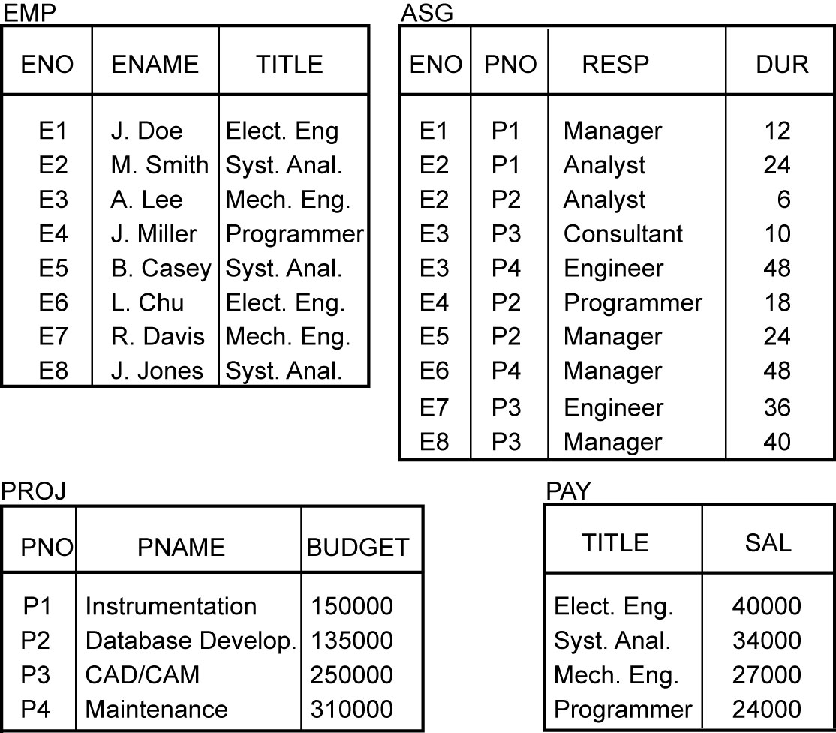
Example

Slide 15
Transparent Access
SELECT ENAME,SAL
FROM EMP,ASG,PAY
WHERE DUR > 12
AND EMP.ENO = ASG.ENO
AND PAY.TITLE = EMP.TITLE
Tokyo
Boston
Paris
Paris projects
Paris employees
Paris assignments
Boston employees
Communication
Network
Boston projects
Boston employees
Boston assignments
Montreal
New
York
Montreal projects
Paris projects
New York projects
with budget > 200000
Montreal employees
Montreal assignments
Boston projects
New York employees
New York projects
New York assignments
Notes:
Animated slide

Slide 16
Distributed Database - User View
Distributed Database

Slide 17
Distributed DBMS - Reality
User
Query
DBMS
Software
User
Application
DBMS
Software
DBMS
Software
Communication
Subsystem
User
Application
DBMS
Software
User
Query
DBMS
Software
User
Query

Slide 18
Types of Transparency
Data independence
Network transparency (or distribution transparency)
Location transparency
Fragmentation transparency
Replication transparency
Fragmentation transparency
Notes:
Data independence is the type of data transparency that matters for a centralised DBMS. It refers to the immunity of user applications to changes made in the definition and organization of data.
Physical data independence deals with hiding the details of the storage structure from user applications. The application should not be involved with these issues, since there is no difference in the operation carried out against the data.

Slide 19
Reliability Through Transactions
Replicated components and data should make distributed DBMS more reliable.
Distributed transactions provide
Concurrency transparency
Distributed transaction support requires implementation of
Distributed concurrency control protocols
Commit protocols
Data replication
problematic for updates
Replication protocols

Slide 20
Potentially Improved Performance
Proximity of data to its points of use
Requires some support for fragmentation and replication
Parallelism in execution
Inter-query parallelism: the ability to execute multiple queries at the same time
intra-query parallelism is achieved by breaking up a single query into a number of subqueries each of which is executed at a different site.

Slide 21
Parallelism Requirements
Have as much of the data required by each application at the site where the application executes
Full replication: the entire database is stored at each site
How about updates?
Mutual consistency:
The condition that requires all the values of multiple copies of every data item to converge to the same value
Freshness of copies:

Slide 22
System Expansion
Issue is database scaling
Emergence of microprocessor and workstation technologies
Demise of Grosh's law

Slide 23
Relationship Between Issues
Directory
Management
Query
Processing
Distribution
Design
Reliability
Concurrency
Control
Deadlock
Management

